Slide 1
Mobile Sensing for Text Entry Correction During Walking
Presented by
Eric Lu
Notes:
0 minutes

Slide 2
Problems With Text Entry During Walking
Text entry is quite challenging when the user is in motion[1][2].
This state can be referred to as situational impairment[3] .
Notes:
0 minutes

Slide 3
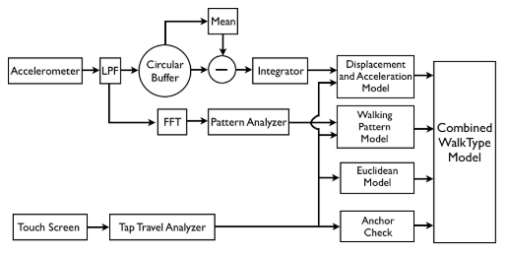
Prior Work on Text Entry During Walking
Goel et a. proposed an approach that leveraged the smartphone’s built-in accelerometer to increase text entry accuracy during walking[1]. Their system is called “WalkType”.
WalkType feeds accelerometer and touch data through three separate models, the displacement and acceleration model, the walking pattern model and the Euclidean model. Each model outputs one of the 27 classes (26 characters + SPACE). The conflict is resolved through a majority vote.

Slide 4
Prior Work on Text Entry During Walking
Goel et a. proposed an approach that leveraged the smartphone’s built-in accelerometer to increase text entry accuracy during walking[1]. Their system is called “WalkType”.
Some of the drawbacks of the WalkType:
Poor model interpretability. The model cannot explain the relationship between the touch points and the motion data.
Issues in voting. It remain a question whether each of the three models should have the same voting power. Additionally, it might be difficult to resolve the conflict if we add another model, for example, a language model, which is commonly used in text entry project. In this case, there is an even number of models.
Overfit. Model trained under the walking conditions results in poor performance when tested under the sitting condition. This suggest that the model is overfitted to the walking condition.

Slide 5
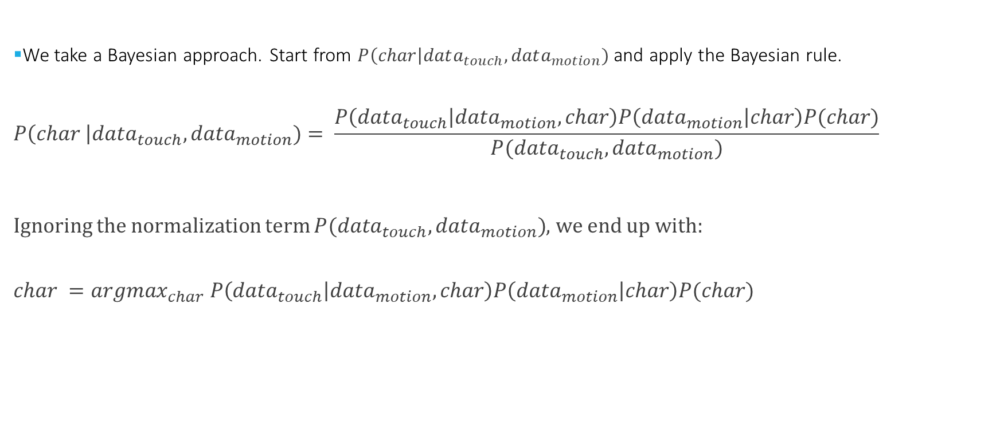
Our Approach
We take a Bayesian approach. Start from $P\left(char\right|data_{touch},data_{motion})$ and apply the Bayesian rule.
$$P\left(char \right|data_{touch},data_{motion})= \frac{P\left(data_{touch} | data_{motion},char\right)P\left(data_{motion} | char\right)P(char)}{P(data_{touch},data_{motion})}$$
Ignoring the normalization term $P(data_{touch},data_{motion})$, we end up with:
$$char =argmax_{char} P\left(data_{touch} | data_{motion},char\right)P\left(data_{motion} | char\right)P(char)$$

Slide 6

Model Derivation: $P\left(data_{touch} | data_{motion},char\right)$
We interpret this components as the distribution of touch points given the phone motion and the character.
We use Bayesian linear regression model to model this component.
We use the accelerometer data and the gyroscope data as $data_{motion}$

Slide 7
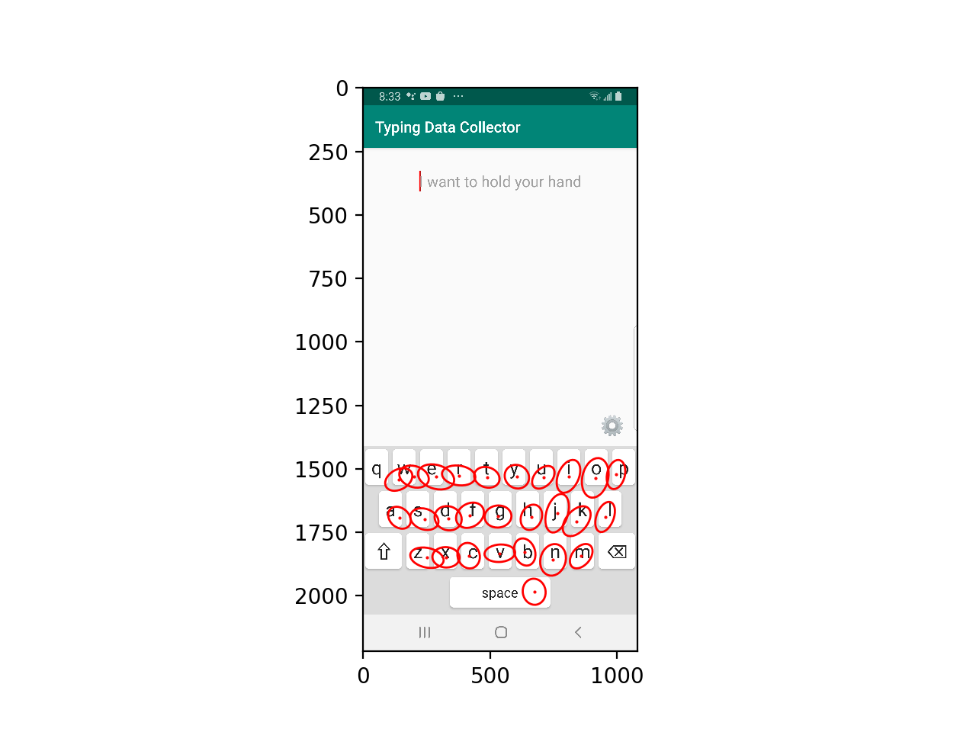
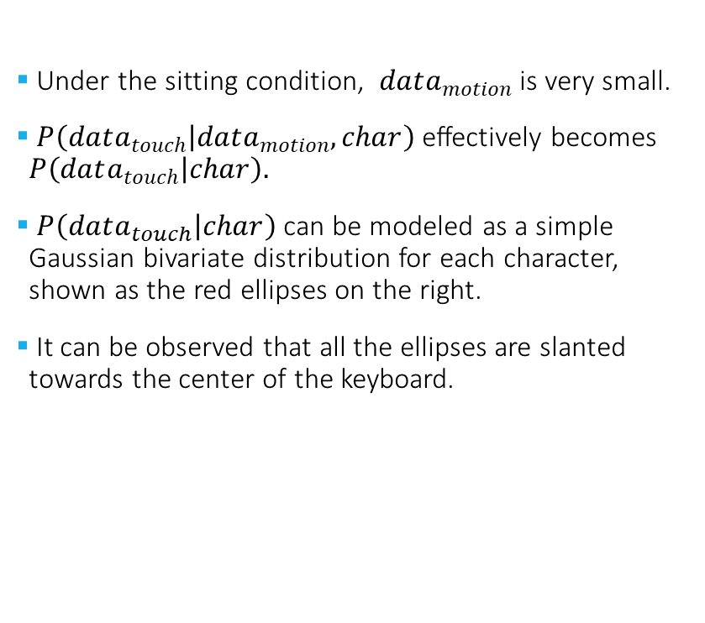
Model Derivation: $P\left(data_{touch} | data_{motion},char\right)$
Under the sitting condition, $data_{motion}$ is very small.
$P\left(data_{touch} | data_{motion},char\right)$ effectively becomes $P\left(data_{touch} | char\right).$
$P\left(data_{touch} | char\right)$ can be modeled as a simple Gaussian bivariate distribution for each character, shown as the red ellipses on the right.
It can be observed that all the ellipses are slanted towards the center of the keyboard.

Slide 8
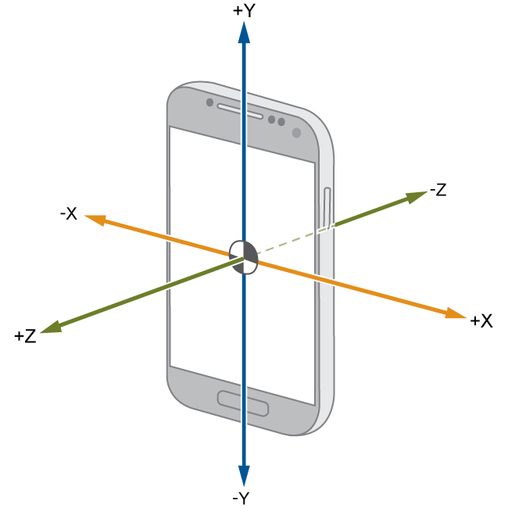
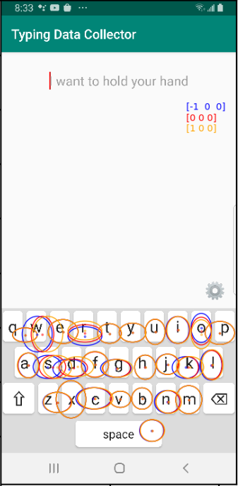
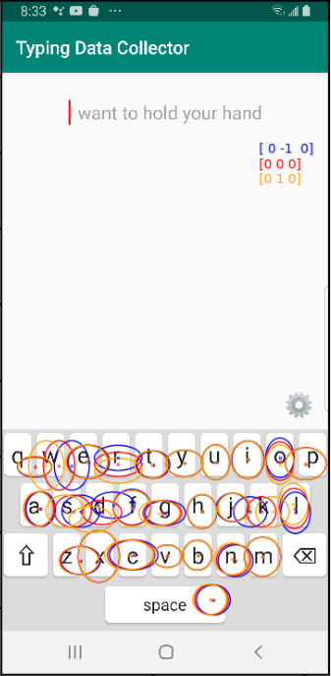
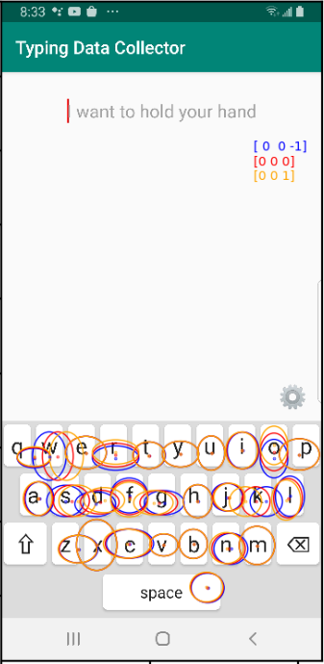
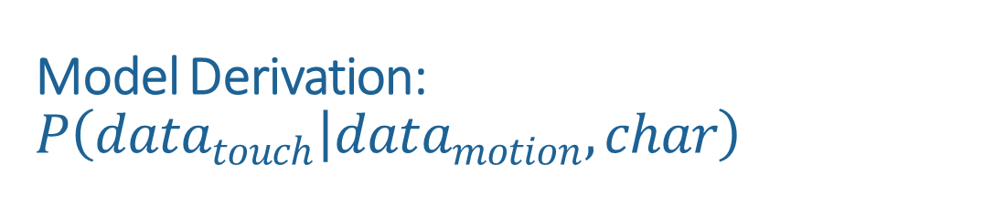
Model Derivation: $P\left(data_{touch} | data_{motion},char\right)$
Rotation around X
Rotation around Y
Rotation around Z
Under the walking condition, we can observe how the touch points distribution changes in response to the motion.
For example, the images on the right shows how touch points change in response to the rotation around the three axes, in rad/s.
Blue and gold represents counterclockwise and clockwise rotation, respectively, while red represents no rotation.

Slide 9
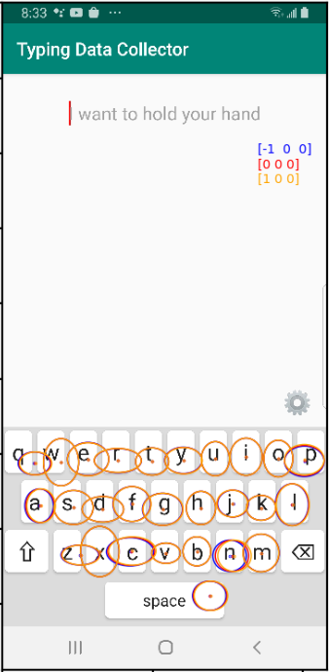
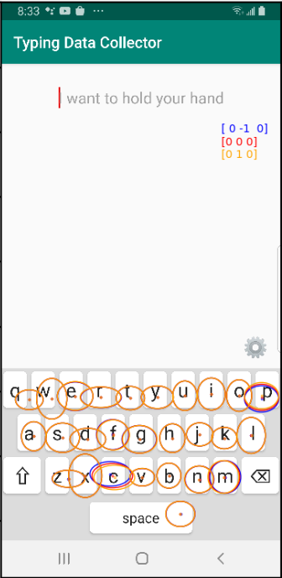
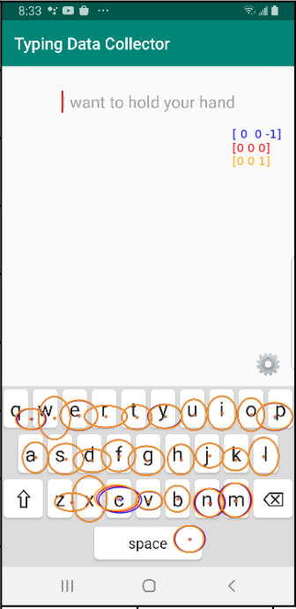
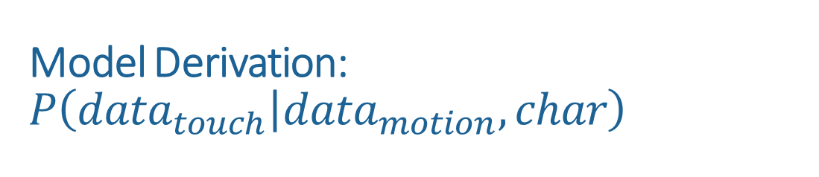
Model Derivation: $P\left(data_{touch} | data_{motion},char\right)$
Accel along X
Accel along Y
Accel along Z
Under the walking condition, we can observe how the touch points distribution changes in response to the motion.
Similarly, the images on the right shows how touch points change in response to the acceleration along the three axes, in m/s^2
Blue and gold represents negative and positive acceleration, respectively, while red represents no acceleration.

Slide 10
Model Derivation: $P\left(data_{motion} | char\right)$
We interpret this components as the distribution of motion given the phone motion and the character.
We use a Gaussian multivariate model to model the distribution.

Slide 11
Model Derivation:$P(char)$
We model P(char) with a language model.
In this case, we choose to use a simple character level 5-gram language model with Kneser - Ney smoothing technique to reduce data sparsity.
We trained the language model on Brown Corpus [R].
For example, ‘l’ = $arg\max_{next char}{\text{P}\text{(}\text{next} \text{char}\text{| }\text{context}\text{ = ‘}\text{internationa}\text{’)}}$

Slide 12
Results
After performing a 10-fold cross validation with 5 participants, we arrive at the following results.
The original error rate under the sitting condition: 0.0856175219729209
The original error rate under the walking condition: 0.01131931118546897
 | Trained on the sitting data | Tested on the walking data
Tested on the sitting data | 0.0475898143135 | 0.0493274584782
Tested on the sitting data | 0.0671423812629 | 0.0629528610680

Slide 13
Findings & Discussion
The motion of the phone causes the distribution of the touch points to change.
The change in the touch point distribution is affected by the rotation more than the acceleration of the phone.
Using gyroscope data as features produce better results than acceleration data.
Our model can correct the typing error made under the sitting condition even if trained with the data collected under the walking condition. There is less concern with overfitting.
More participants are needed for verification.

Slide 14
Thanks for listening !

